Slide 1
caCORE SDK
Satish Patel

Slide 2
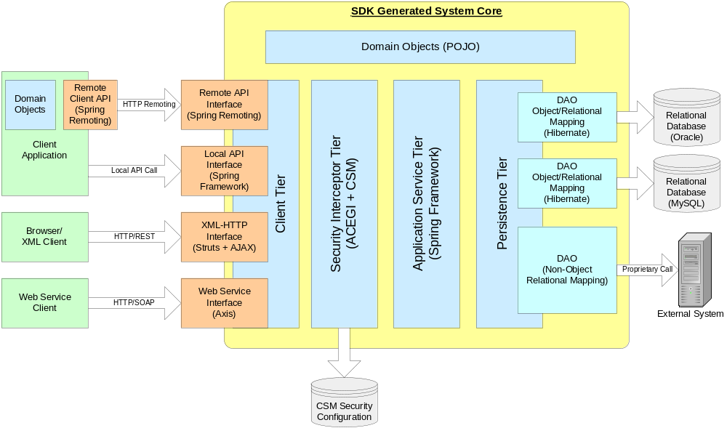
SDK Architecture

Slide 3
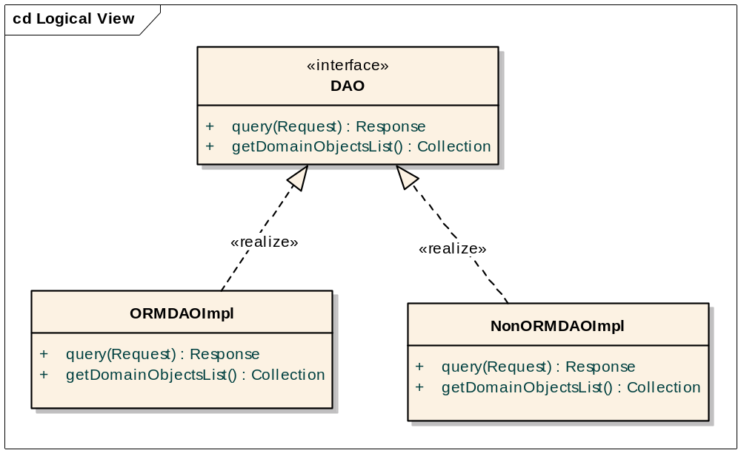
Extending Persistence Tier

Slide 4
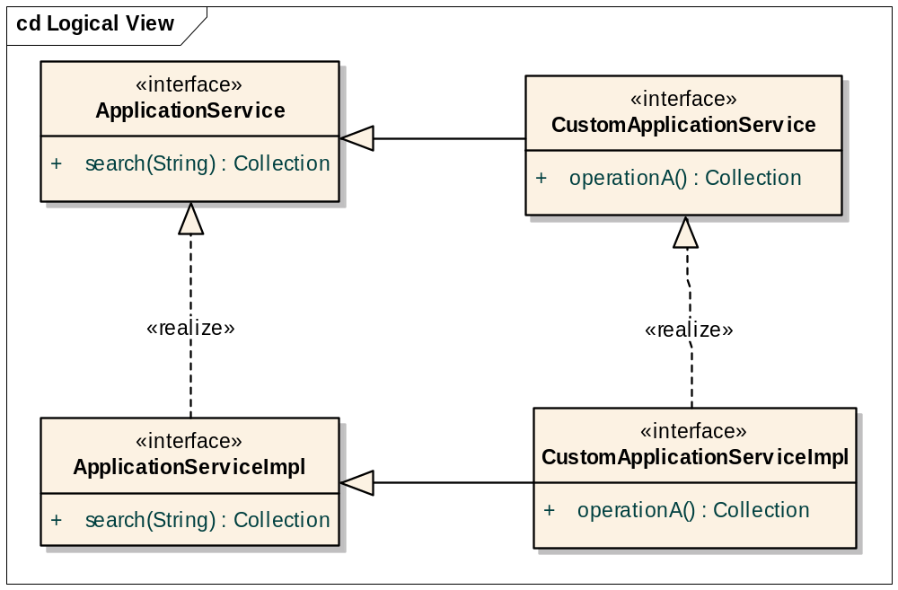
Extending Application Service

Slide 5
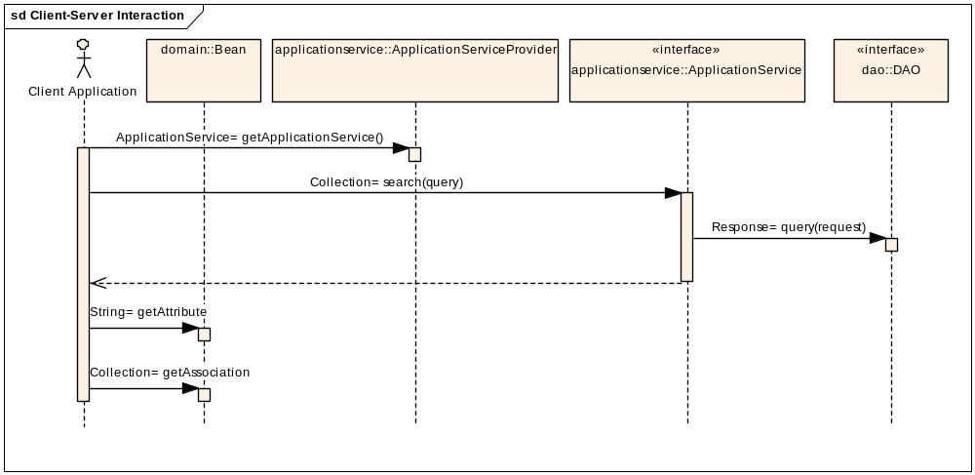
Client Server Communication

Slide 6
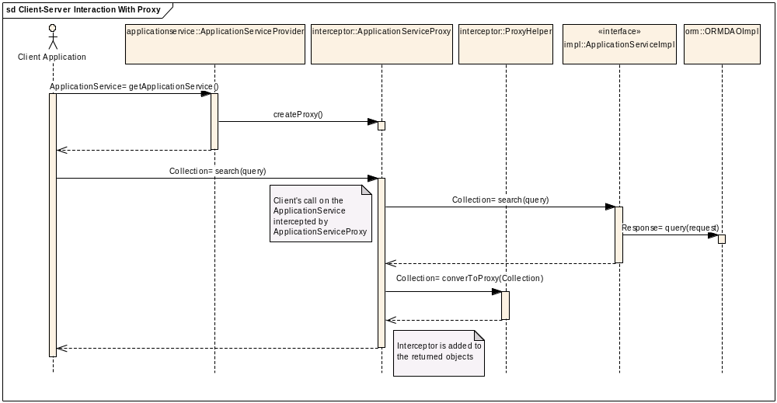
Proxy Interception on
Application Service

Slide 7
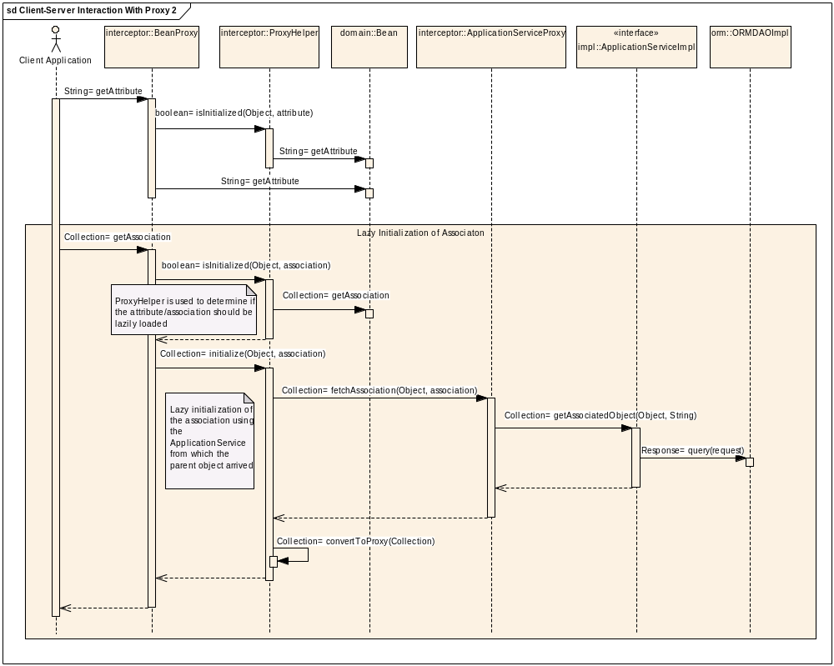
Proxy Interception on Beans

Slide 8
SDK Generated Artifacts
POJOs
ORM Files
  Mapping File (hbm.xml)
  Configuration file (cfg.xml)
  EHCache file (for hibernate)
WSDD
XSD
XML Mapping files

